Slide 1

Department of Computer Science and Engineering
CLOUD COMPUTING LAB
4. Use GAE Launcher to Launch Web Applications
AIM:
To use Google App Engine (GAE) Launcher to launch web applications.

Slide 2

OBJECTIVE OF THE EXPERIMENT
Create a project in Google Cloud Console
Configure a web application for Google App Engine
Create a basic static website
Configure the application using app.yaml
Deploy the application using Google Cloud SDK
Launch and view the web application in a browser

Slide 3
PROJECT STRUCTURE
Project/
│
├── app.yaml
│
└── www/
├── index.html
├── css/
│ └── style.css
├── images/
└── js/
Purpose of files:
app.yaml → Configures the App Engine application
www/ → Contains website files
index.html → Main webpage
css/ → Contains stylesheets
images/ → Stores images
js/ → Contains JavaScript files

Slide 4
CREATING app.yaml
App Engine Configuration
The app.yaml file tells Google App Engine how to handle and serve the application files.
Configuration
Key Point: app.yaml maps incoming URLs to the
corresponding static files in the www
directory.
runtime: python27
api_version: 1
threadsafe: true
handlers:
- url: /
static_files: www/index.html
upload: www/index.html
- url: /(.*)
static_files: www/\1
upload: www/(.*)

Slide 5
CREATING THE WEB PAGE
Creating index.html
The index.html file is stored inside the www directory.
<html>
<head>
<title>Hello, world!</title>
</head>
<body>
<h1>Hello, world!</h1>
<p>
This is a simple static HTML file
served from Google App Engine.
</p>
</body>
</html>
Output: A simple Hello, World! webpage is
created and prepared for deployment.

Slide 6
DEPLOYING THE APPLICATION
Deploying to Google App Engine
Open the terminal in the project root directory.
Make sure app.yaml is present.
Deploy the application using:
gcloud app deploy
Google App Engine uploads and deploys the application.
An optional project ID or version ID can also be specified.
Command:
gcloud app deploy

Slide 7
LAUNCHING & RESULT
Launching the Web Application
After deployment, the application can be opened using:
gcloud app browse
The application is then opened in the browser using the App Engine URL format:
https://PROJECT_ID.REGION_ID.r.appspot.com
Result:
Thus, the GAE Launcher was used to launch the web application successfully.

Slide 8
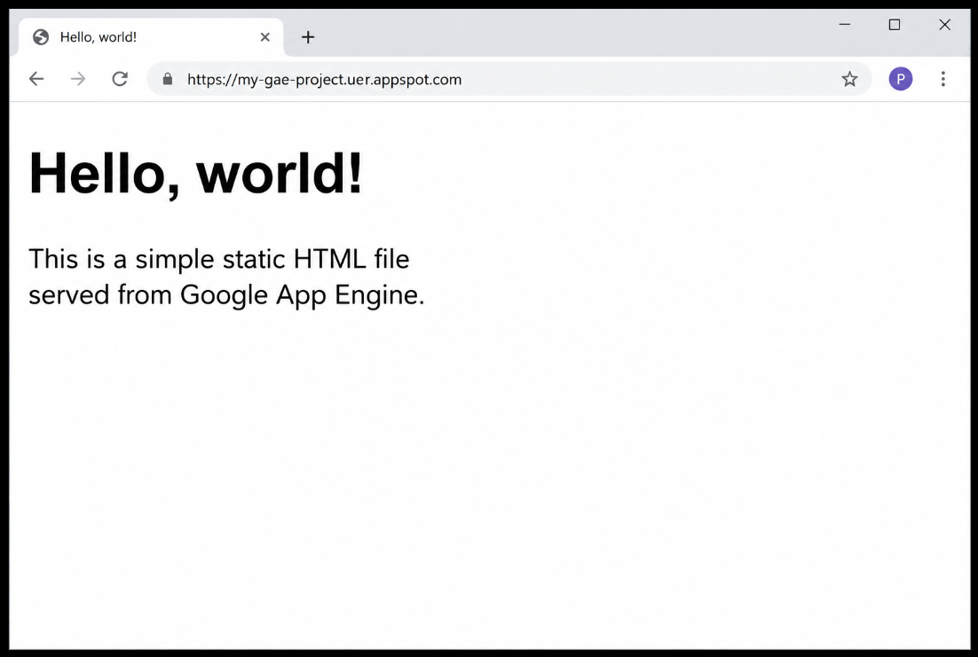
OUTPUT

